Slide 1
Project presentation on Os algorithm tester
Course Title: Information SYSTEM & DESIGN LAB
Course Code: CSE-438 Section: 191D7
Presented By - 01
Umme Loara -191002187
Sadia Binta Sadek -191002088
Faria Nahin -191002215
Department of CSE,
Green University of Bangladesh.
Presented To
Md. Riad Hassan
Lecturer,
Department of CSE,
Green University of Bangladesh.

Slide 2
Table of content
Introduction
Objective
Motivation
Goals to Achieve
Planning
Analysis
Steps of Processes by Blocks
Design
Implementation
System’s functions & services
Registration & Login Form
Testing & Installation
Maintenance
Future scope of it
Overview
References

Slide 3
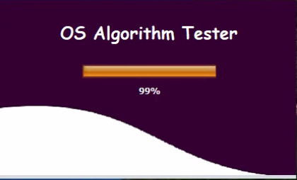
Introduction
In this project, an operating system algorithm based application for the users has been constructed where the users will get the results of their desired algorithm as well as the details steps about it.

Slide 4

Objectives
To enrich our knowledge in Operating System.
To develop the idea of algorithms converter.
To gather knowledge of memory management techniques, CPU Scheduling Algorithm, Contagious Memory Allocation Technique, Deadlock Avoidance, File allocation strategies.

Slide 5

Motivations
Before implementing a algorithm, at first we understand the algorithm practically.
When students do the algorithm in practice, they have doubts about whether their algorithm is done or not.
To find or solve all the algorithm in one place, we choose this project.

Slide 6
Goals to achieve
Constructing Environment or demo model
Finding out proper requirements
Constructing diagrams & structures
Implementing logics into code
Proper Usability & Efficiency
Testing

Slide 7
Planning
Identification of the system for development
Feasibility assessment
Creation of project plan
Contiguous Memory Allocation Technique
Memory Management System
CPU Scheduling Algorithm
File Allocation Strategies
Deadlock Avoidance
Fig-2: Main Block

Slide 8
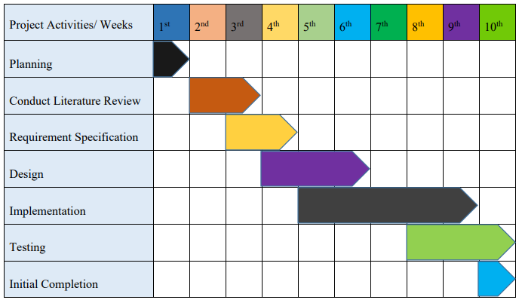
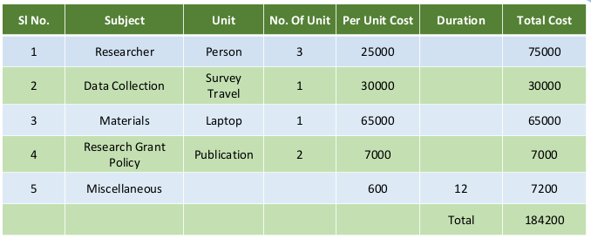
Gantt Chart & Budget Plan
Fig-3: Gantt Chart
Fig-4: Budget Plan

Slide 9
Analysis
Studied System Requirement.
Performing a detailed analysis
System Features
UI Design
Easier Explanation
Advanced Algorithm Terminal
Previous Activity Tracking
User Rights Management
Document Management System
Fig-5: System Requirement

Slide 10
Steps of processes by blocks
creating a simple interface
asking user to perform an action
perform MVT, MFT
perform FCFS, SJF, Priority & Round Robin sheduling
5 for deadlock Avoidance
perform Bnaker's Algorithms
END
1 for Memory Management System
2 for CPU Scheduling Algorithm
3 for Contiguious memory allocations technique
perform
Sequential,Linked. Indexed strategies
4 for File Allocation Strategies
perform worst fir, best fir, first fit algorithms
Fig-6: Process

Slide 11
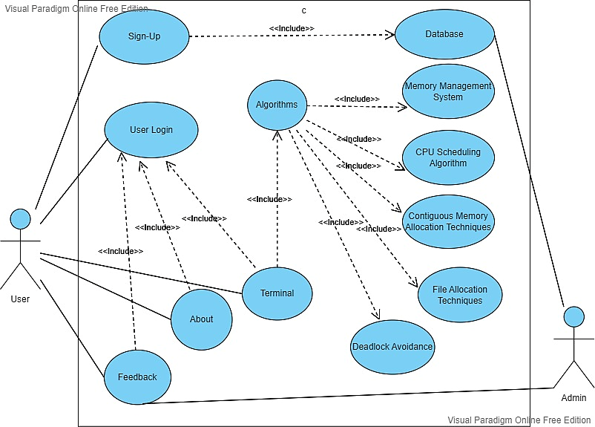
Design
Fig-7: Use Case Diagram

Slide 12
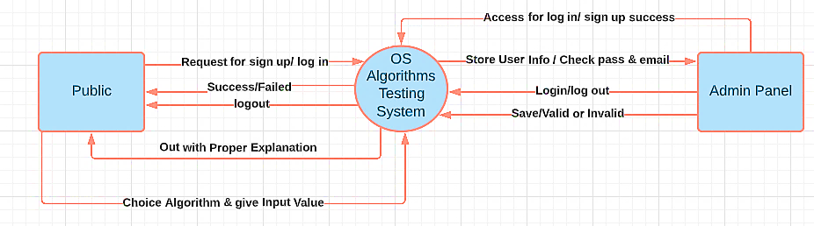
Continued…
Fig-8: 0-level DFD Diagram

Slide 13
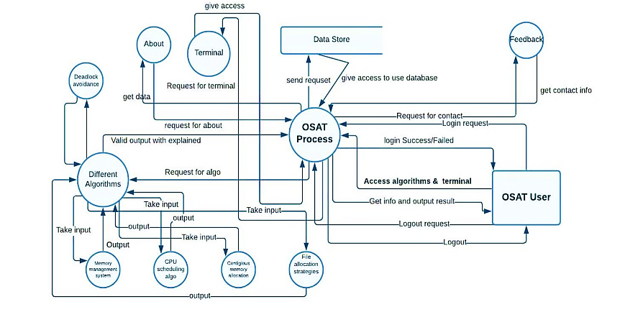
Continued…
Fig-9: 1-level DFD Diagram

Slide 14
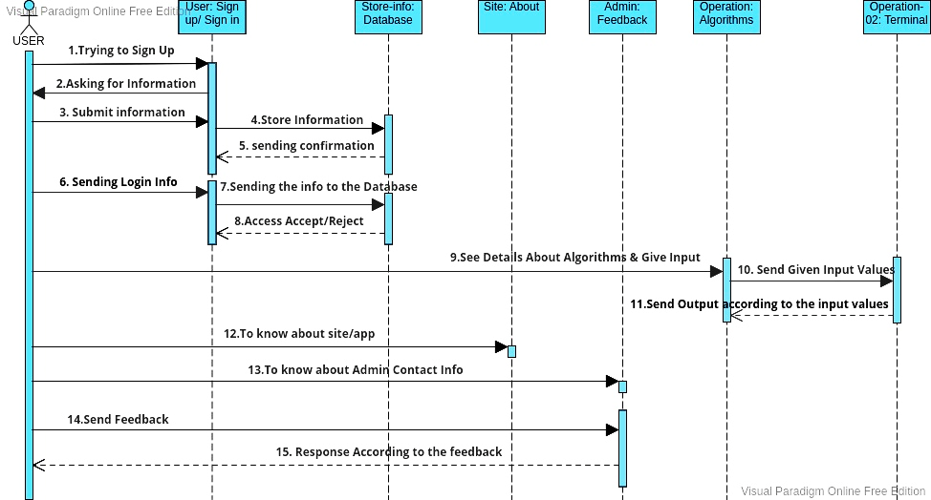
Continued…
Fig-10: Sequence & Communication Diagram

Slide 15
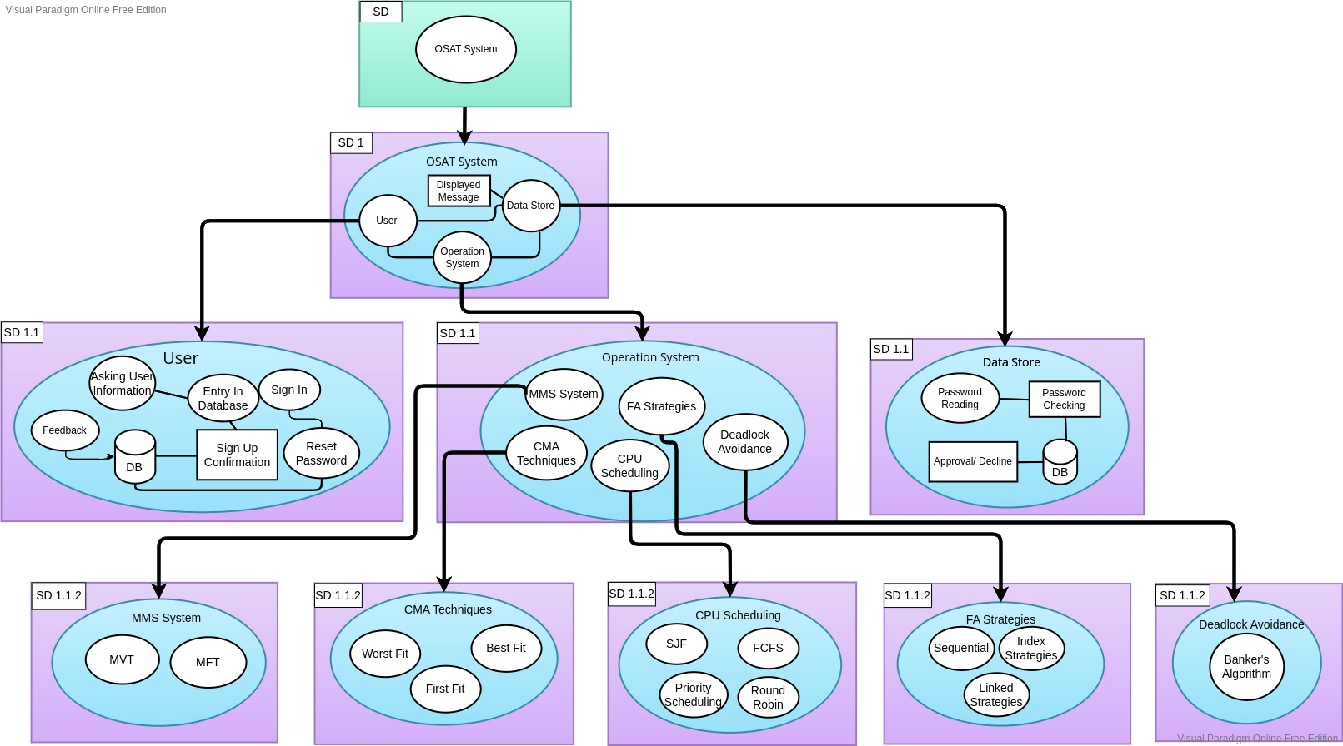
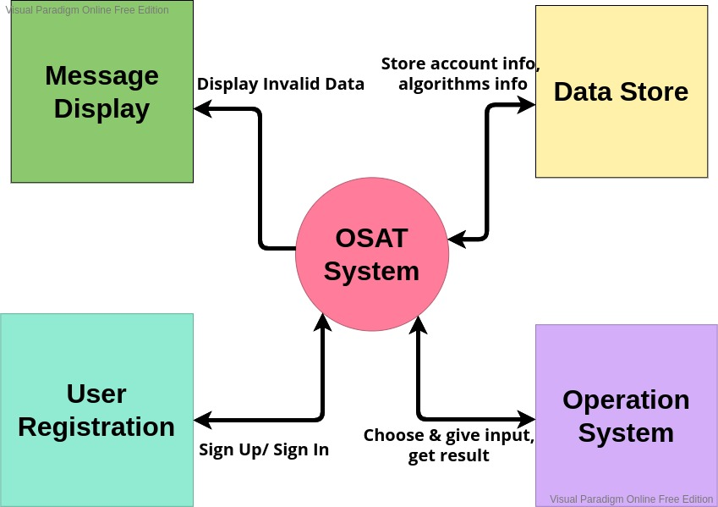
Continued…
Fig-11: Higher Level Architecture
Fig-12: Lower Level Architecture

Slide 16
Implementation
Hardware:
Operating System: Window
Hard Disk: 1T
RAM: 16GB
Processor: Pentium (R) Dual-Core CPU
Software:
NetBeans IDE 8.2
Visual Studio Code 1.61.1 (user setup)

Slide 17
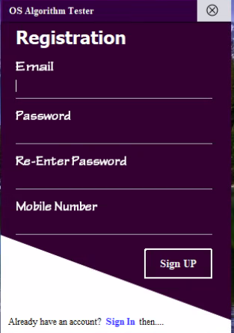
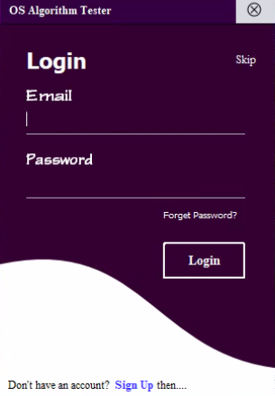
Registration & Login FORM
Fig-13: Registration & Login Form

Slide 18
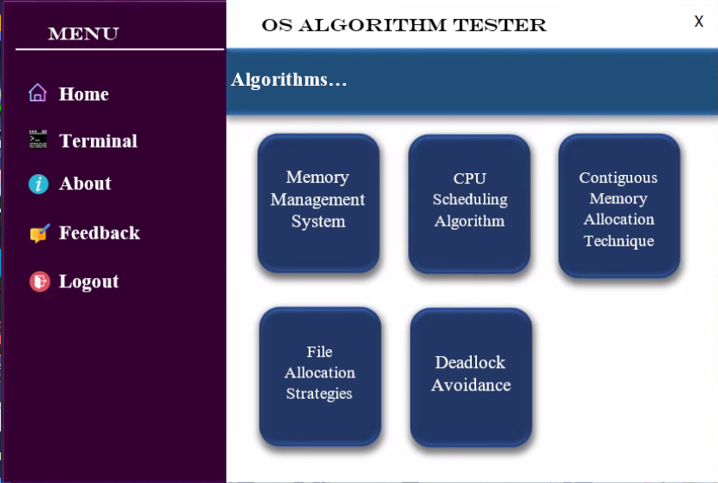
Functions and services
Main interface containing all the properties of the system.
Fig-14 Main Interface

Slide 19
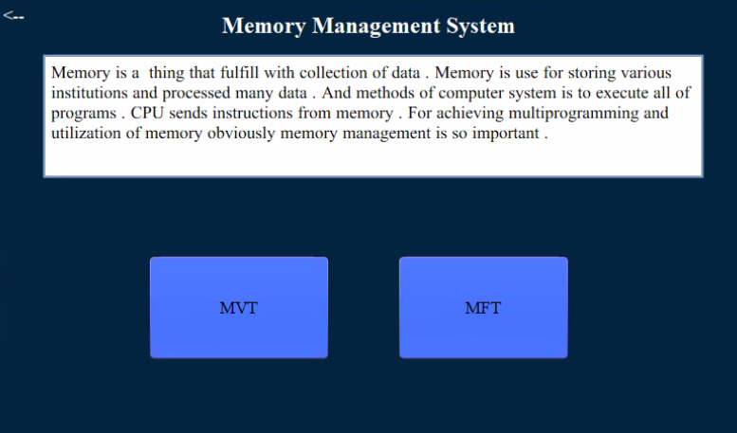
Functions and services
Fig-15: Memory Management System

Slide 20
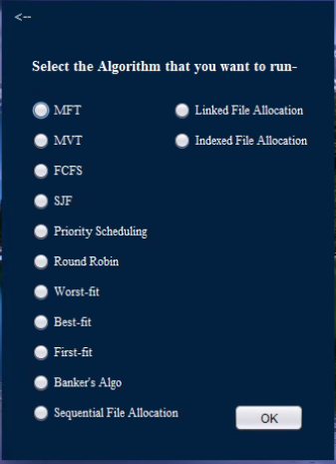
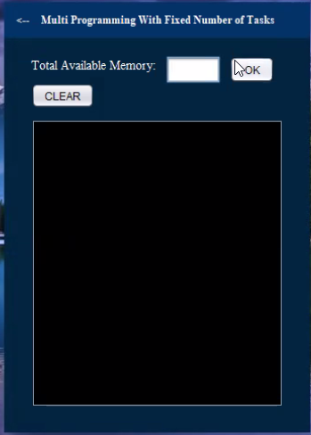
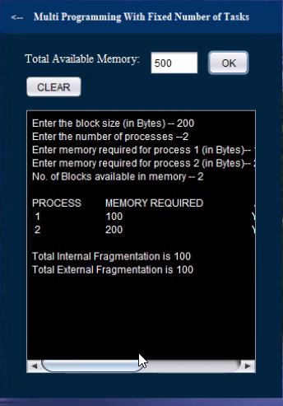
Finding algorithm
Fig-16: Terminal
Fig-17: Input Screen
Fig-18: Output Screen

Slide 21
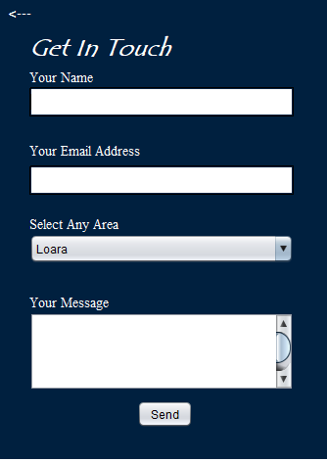
Feedback Section

Slide 22
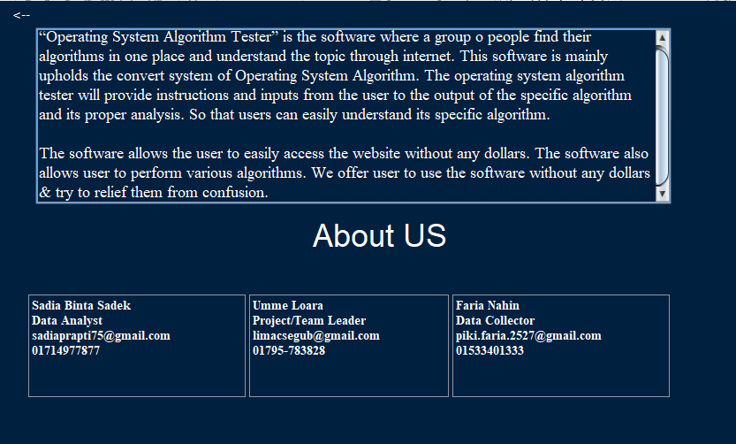
About Section

Slide 23

Testing & Installation
Testing:
White Box Testing
Manual Testing
Installation:
Need Internet connection to install android version.

Slide 24

Maintenance
If any new version release, the system will automatically update.
By feedback option & about option user can contact with admin for further change.

Slide 25
Future scope of it
Can be used for conversion purpose simply
Can be used in educational institutions
Can be used in a company or industry for the management of their data
Can be used by normal users also
May be used into applications based on OS algorithms

Slide 26
Overview
Choosing Algorithm
Entry data
Get Results
Get explanation
Feedback

Slide 27
References
[1] Andrew S. Tanenbaum and Albert S. Woodhull (2007). Operating Systems: Design and Implementation, Prentice Hall, 3 rd Edition.
[2] Sandeep Jain; Last Updated: 28 Jun, 2021;Last visit: 10/13/21; https://www.geeksforgeeks.org/operating-systems/
[3] Mohammad Mohtashim; Last visit: 10/13/21; https://www.tutorialspoint.com/operating_system/
[4] Abhishek Ahlawat; Last visit: 10/13/21; https://www.studytonight.com/operating-system/
[5] Last visit: 10/13/21; https://www.cs.uic.edu/~jbell/CourseNotes/OperatingSystems/
[6] Sandeep Jain; Last Updated: 28 Jun, 2021;Last visit: 11/03/21; https://www.geeksforgeeks.org/types-and-components-of-data-flow diagram-dfd/
[7] Ben Dilts; Last visit: 11/03/21; https://d2slcw3kip6qmk.cloudfront.net/marketing/blog/Updates/dfdsymbols-and-notation.png

Slide 28


